Slide 1
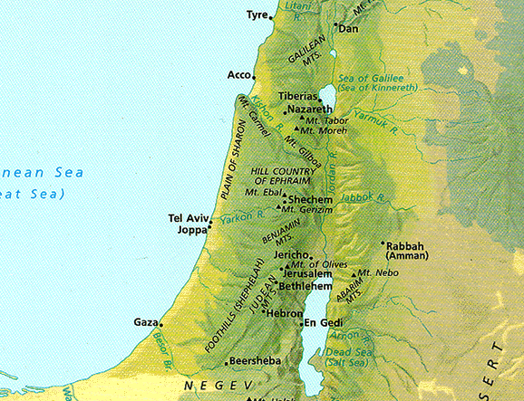
Gjpa
Vw;ghl;L ,];uNaypd; jiuj;Njhw;wk;
Dr. Rick Griffith • Singapore Bible College • BibleStudyDownloads.org

Slide 2

,d;iwa cyfk;

Slide 3

etPd kj;jpa fpof;F
9

Slide 4

nkhrgj;Njkpah
9
ijfpup];
mrPupah
A+g;ujP];
ghgpNyhd;
ngu;rpah
rhy;bah
ghurPf tisFlh

Slide 5
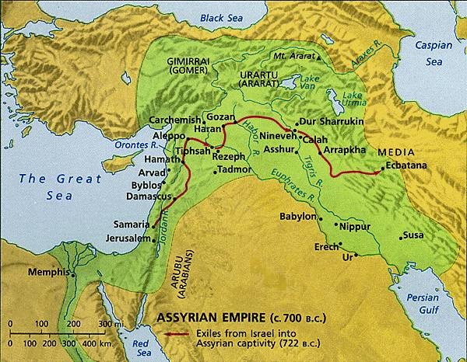
gz;ila neUq;fpa fpof;F
9
nrOk;gpiw epyk;

Slide 6
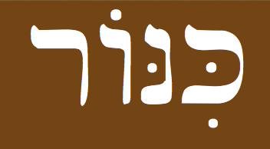
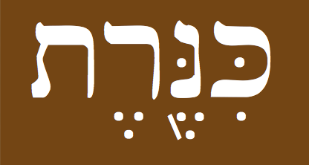

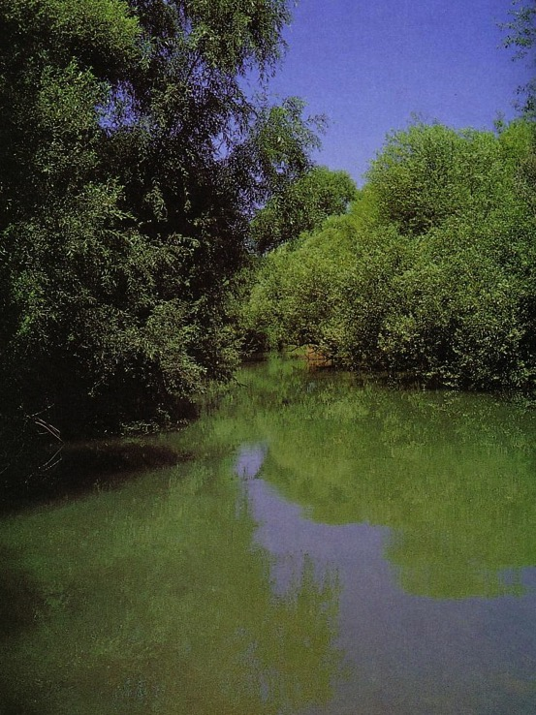
,];uNaypd; ePHepiyfs;
rANKi n.m. fpd;duk; – fpd;duk;, je;jp cgfuzq;fs; gpugykhd gupRj;jj;jpw;Fupa ,irf;fUtp (B4604)
10
Gjpa Vw;ghl;L fypNyaf;fly;
gioa Vw;ghl;L fpd;dNuj;J
105 km. (65 mi.)
kj;jpajiuf;fly;
215 km. (135 mi.)
NahHjhd; ejp
cg;Gf;fly;
Nahal Senir, NahHjhd; ejpapd; xNunahU %yhjhuk;

Slide 7
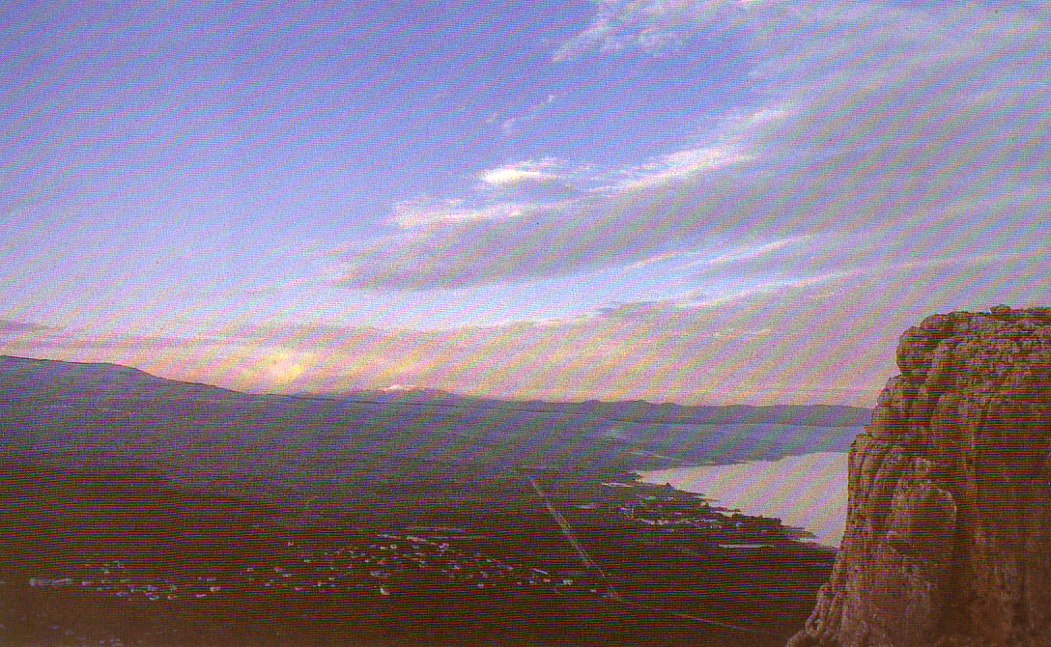
fypNyaf;fly;
(fpof;if Nehf;fpajhd tlf;Ff;fiu)

Slide 8
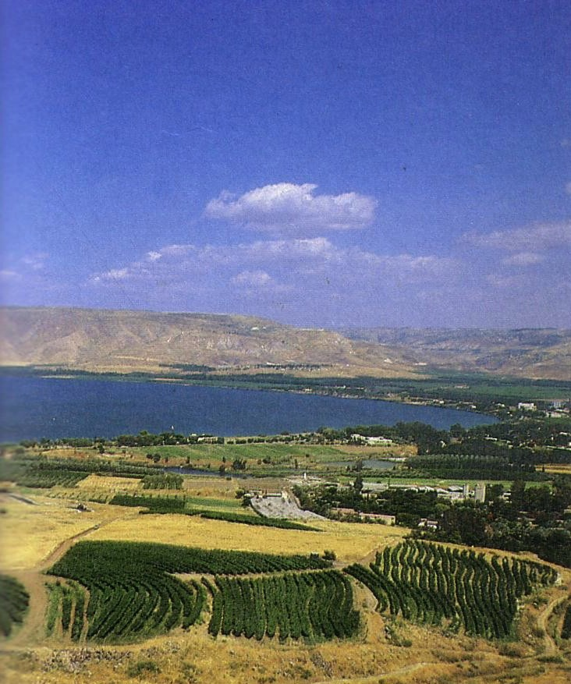
fypNyaf;fly;
fpof;if Nehf;fpajhd njd;fiu

Slide 9

,];uNaypd; kiyfs;
10
vHNkhd;
fHNky;
jhNghH
fpy;Nghth
xyptkiy
NeNgh
XH

Slide 10
,];uNaypd; gFjpfs;
(gioa Vw;ghL)
10
ghrhd;
fypNyah
,];uNay;
fPNyahj;
mk;Nkhd;
A+Njah
Nkhthg;
VNjhk;

Slide 11
,];uNaypd; gFjpfs;
(Gjpa Vw;ghL)
10
ngj;jhdpah
fypNyah
rkhupah
njf;NfhNghyp
ngNuah
A+Njah
,JNkah
muhgpah

Slide 12
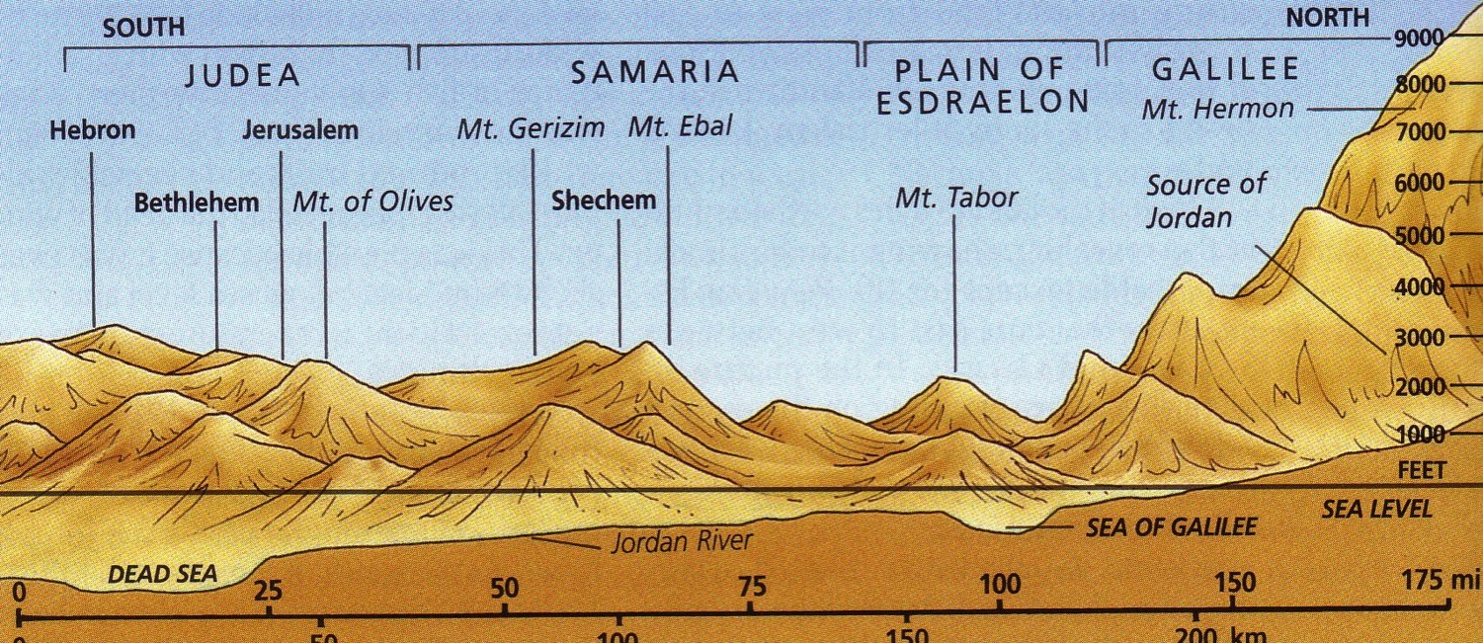
jiukl;lk;
10

Slide 13

tl> njd; gpupTfspd; jiukl;l Njhw;wk;
10
10
fiuNahur;rkntsp

Slide 14
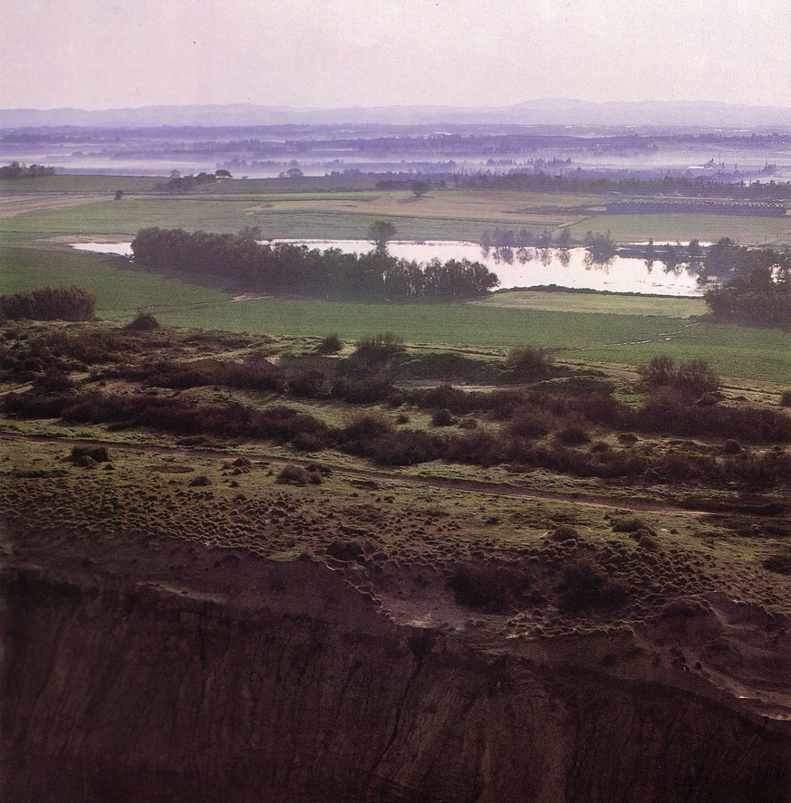
fiuNahur;rkntsp
10
FHfhH (kzw;fy;)
kiyabthuj;jpd; Kd; Gwj;jpypUe;J fpof;Fg; Gwkhf ghHf;Fk;nghOJ fhzg;gLk; gpsTfs;
Notes:
These ridges provide a natural barrier from water running westward to the Great Sea.

Slide 15
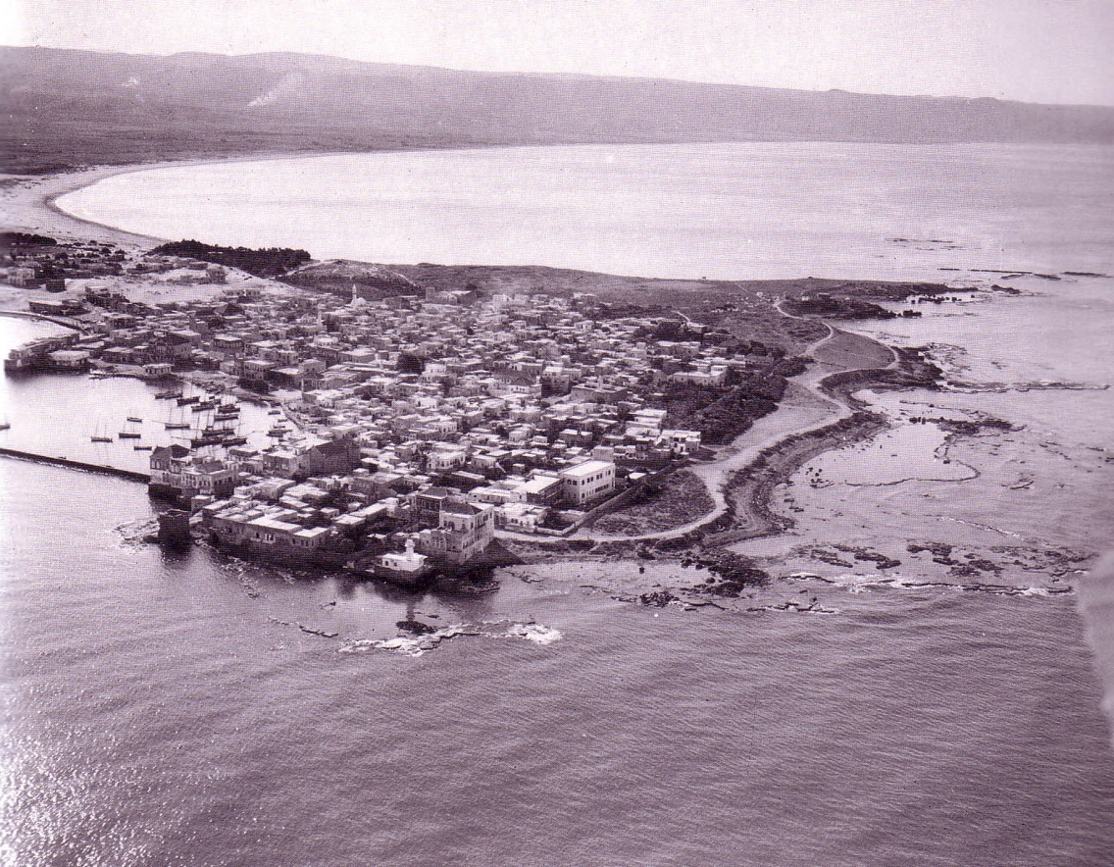
fiuNahur;rkntsp
10
jPU

Slide 16
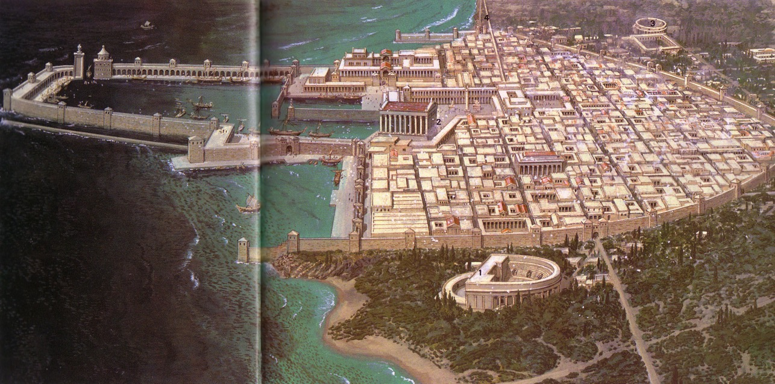
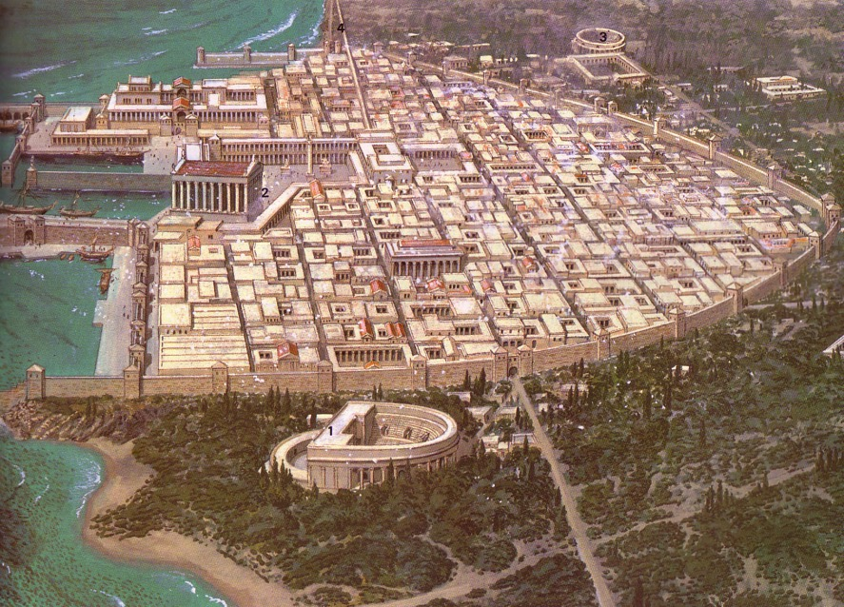
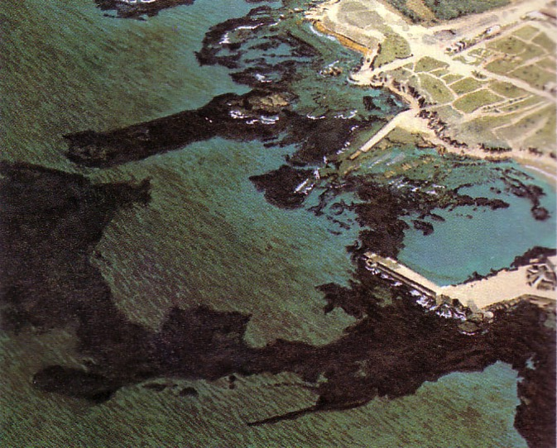
fiuNahur;rkntsp
10
rpNrupah

Slide 17
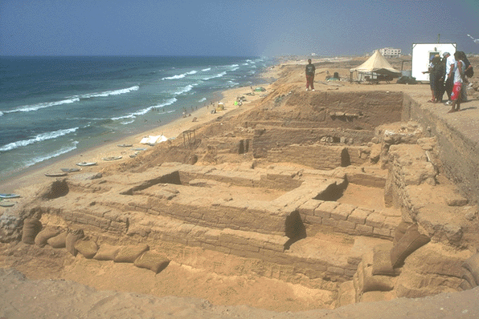
fiuNahur;rkntsp
10
fhrh

Slide 18
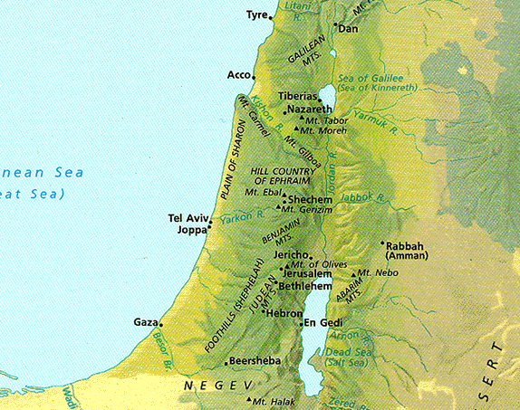
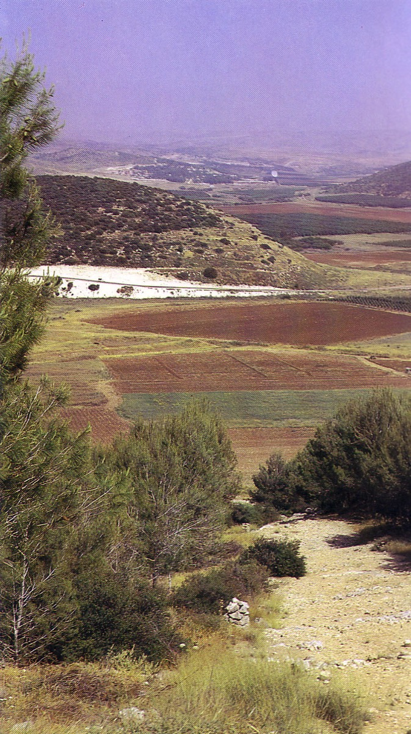
tl> njd; gpupTfspd; jiukl;l Njhw;wk;
10
rkepyk;
kiyfSk; gs;sj;jhf;FfSk;

Slide 19
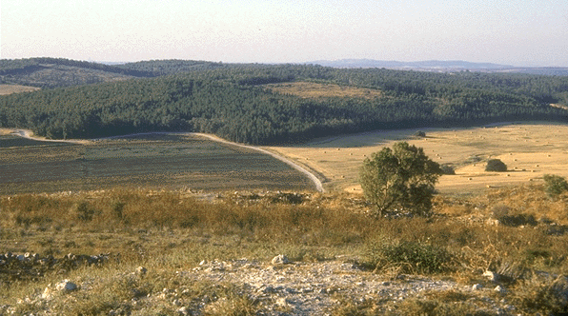
rkepyk;
10
tay;epyk;

Slide 20
tl> njd; gpupTfspd; jiukl;l Njhw;wk;
10
kj;jpa kiyehLfs;

Slide 21
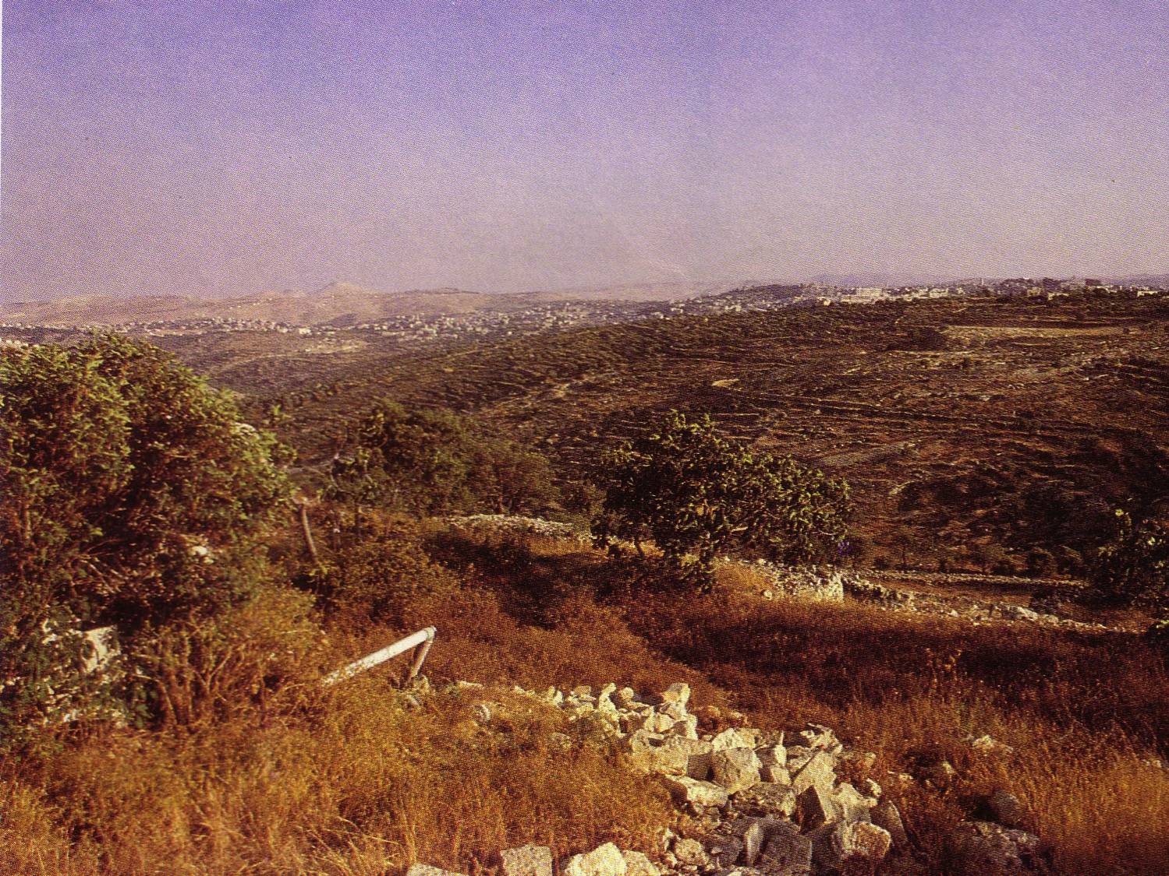
A+Nja kiy
10

Slide 22
tl> njd; gpupTfspd; jiukl;l Njhw;wk;
10
nkfpNjh gs;sj;jhf;F vdTk; miof;fg;gLfpwJ
na];Nuy; gs;sj;jhf;F
kj;jpa kiyehLfs;

Slide 23
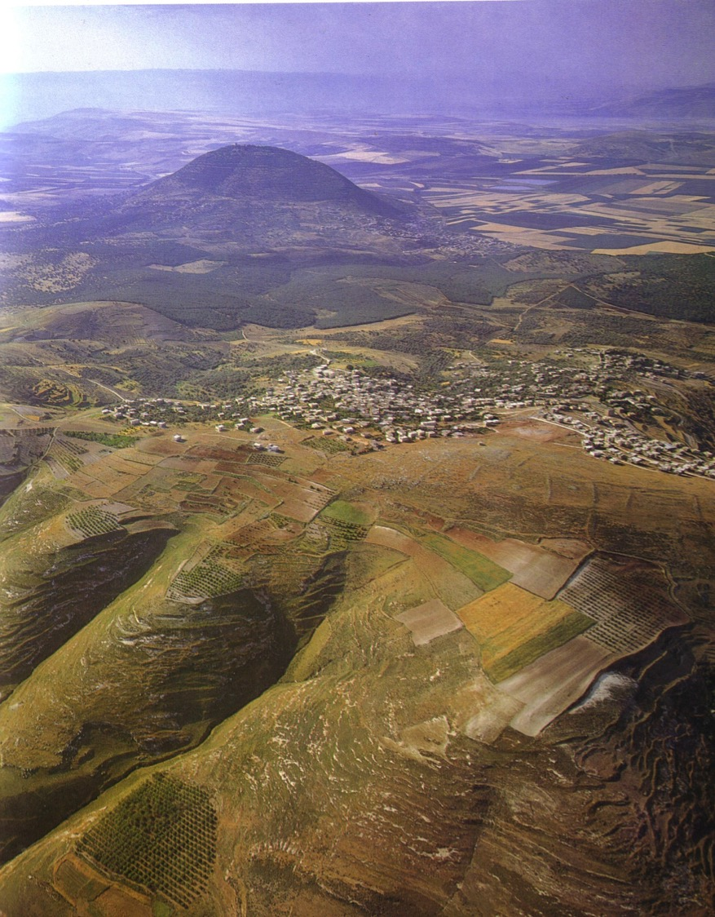
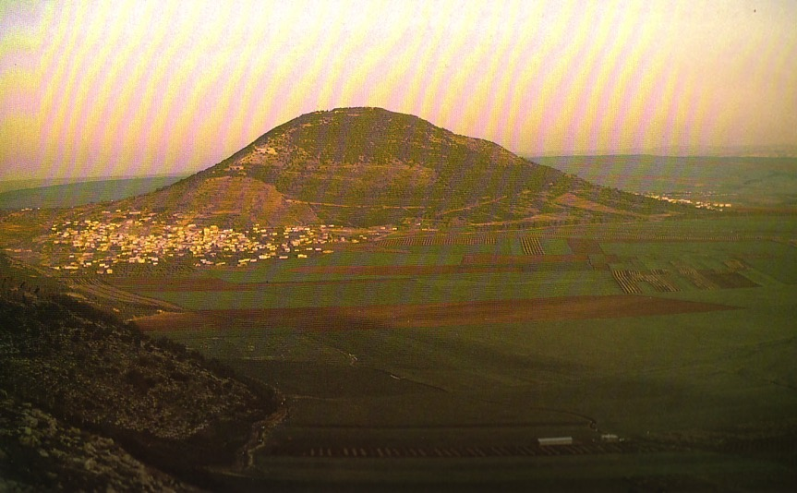
na];Nuy; gs;sj;jhf;fpYs;s jhNghH kiy
10

Slide 24
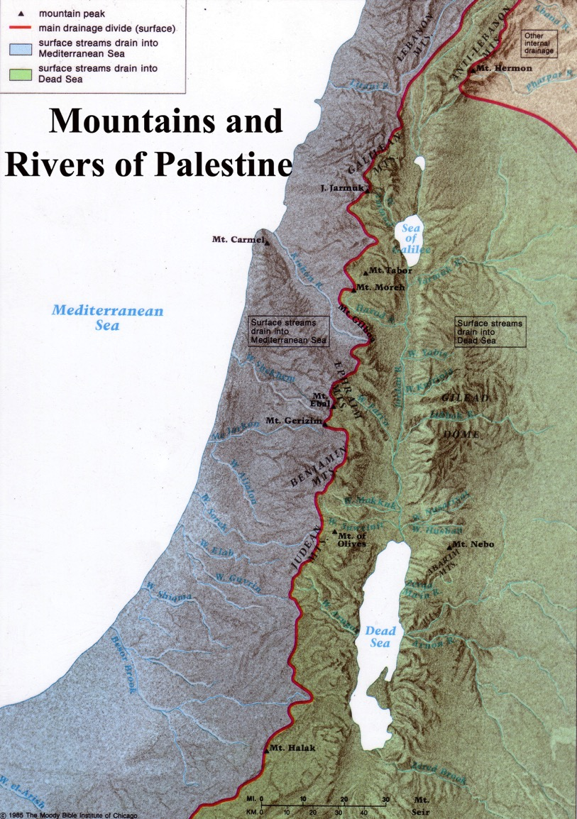
kj;jpa kiy gpuNjrk;
10
KfLfs; fpof;F my;yJ Nkw;if Nehf;fp ePiu nfhz;Lnry;Yk;
njd; gFjpapy; caHe;j jiuNjhw;w mikg;G fhzg;gLfpwJ.

Slide 25
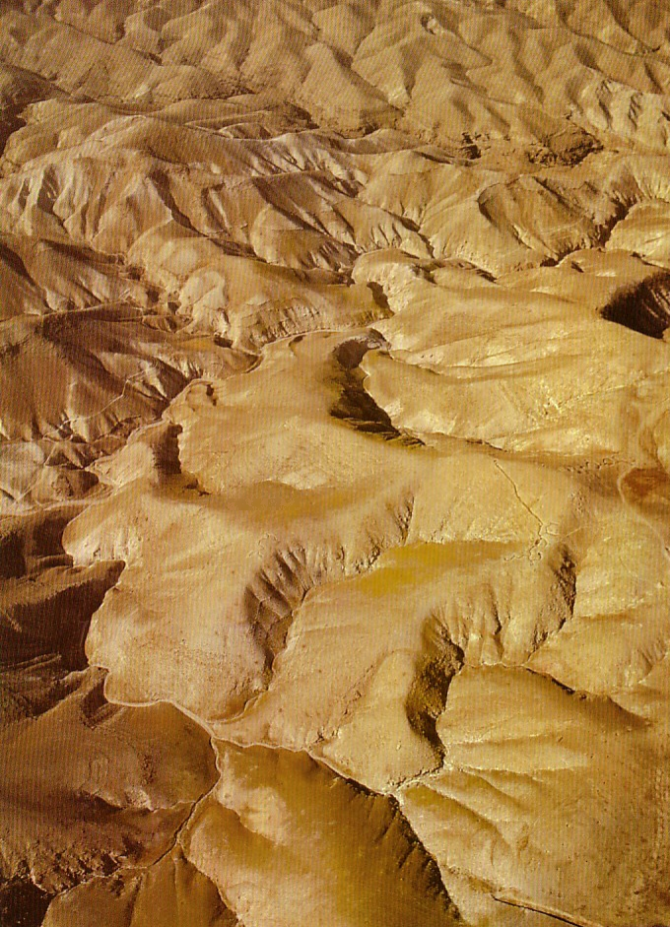
a+Njahg;ghiytdk;
10

Slide 26
tl> njd; gpupTfspd; jiukl;l Njhw;wk;
10
NahHjhd; gpsT

Slide 27

NahHjhd; gpsT
10
Mokhd epyg;gFjp
A+Njah tdhe;juj;jpypUe;J fpof;F jpirapy; fhzg;gLk; cg;Gf;fly;

Slide 28
10
tl> njd; gpupTfspd; jiukl;l Njhw;wk;
NahHjhDf;F ,ilg;gl;l gs;sj;jhf;F

Slide 29
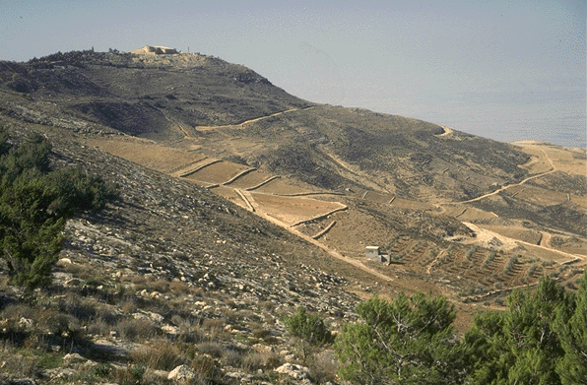
NahHjhDf;F ,ilg;gl;l gs;sj;jhf;F
10
NeNgh kiy

Slide 30
tl> njd; gpupTfspd; jiukl;l Njhw;wk;
10

Slide 31
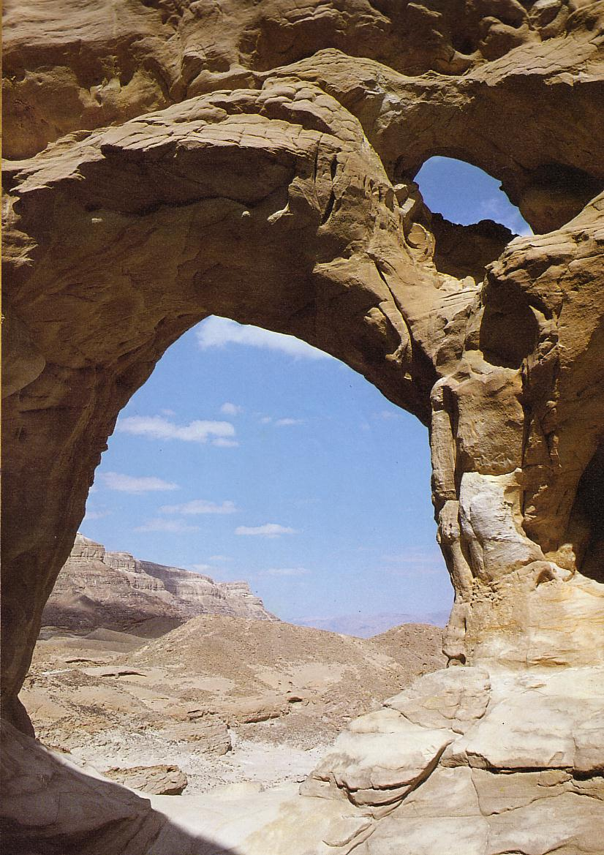
NeNft;
10

Slide 32
,lJGwk;
12
njhz;ik ,];uNaYf;fhd xU gazk;
tyJGwk;
Nkw;Fk; tlf;Fk;
fpof;Fk; njw;Fk;

Slide 33
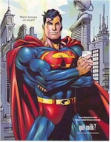
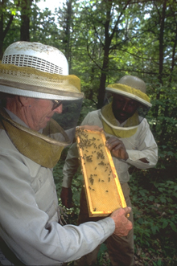
,lJGwk;
12
njhz;ik ,];uNaypd; tho;f;ifKiw
tyJGwk;
tptrhapfs;
Njd; topAk; Njrk;
ke;ijNka;g;gH
ghy; nghopAk; Njrk;

Slide 34
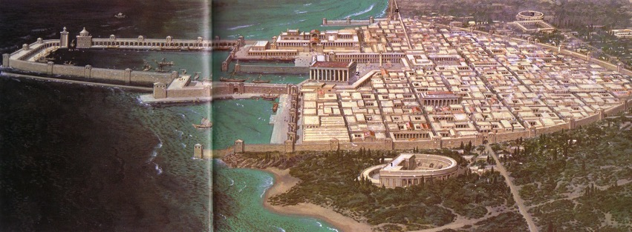
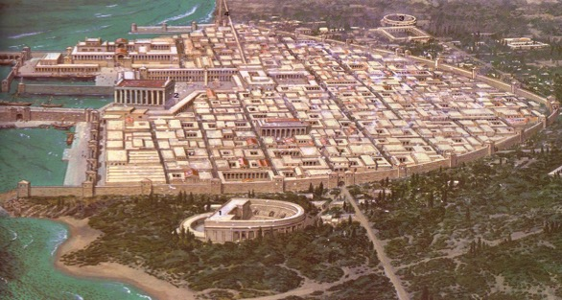
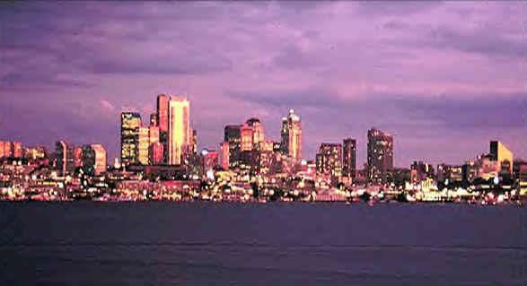
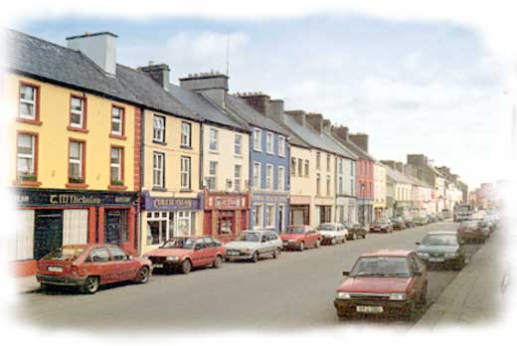
,lJGwk;
12
njhz;ik ,];uNaypd; tho;f;ifKiw
tyJGwk;
40 ghupa efuq;fs;
310 rpwpa gl;lzq;fs;

Slide 35

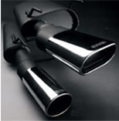
,lJGwk;
12
njhz;ik ,];uNaypd; tho;f;ifKiw
tyJGwk;
,yF
vjpHT$wy;
fbdk;
vjpHT $wKbahik

Slide 36
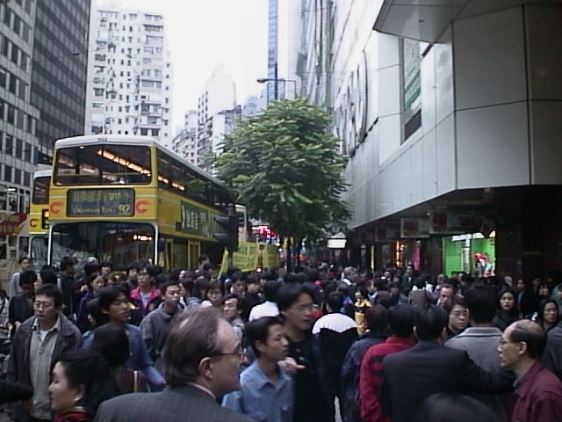
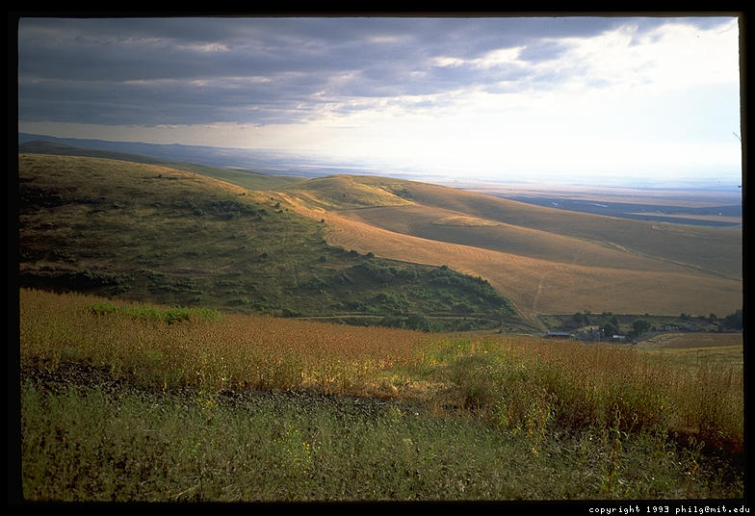
,lJGwk;
njhz;ik ,];uNaypd; tho;f;ifKiw
tyJGwk;
12
jdpik> mikjp
Njrpak;
tzpfk;> ,iur;ry
rHtNjrk;

Slide 37
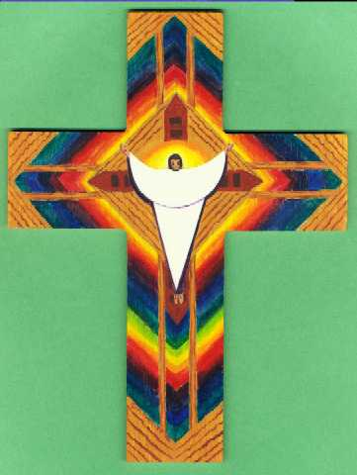
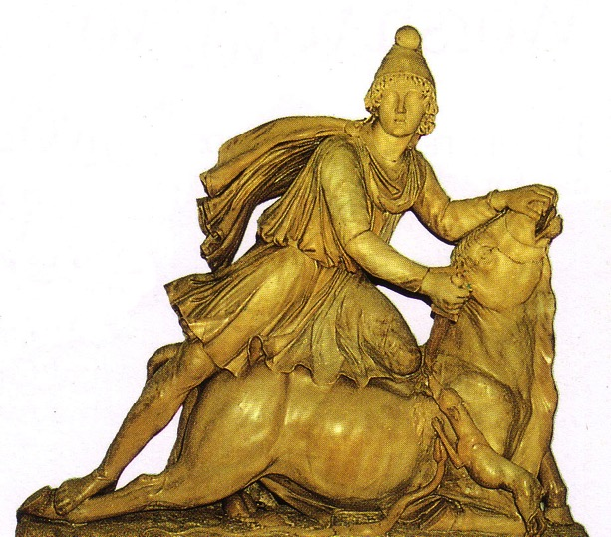
,lJGwk;
12
njhz;ik ,];uNaypd; tho;f;ifKiw
tyJGwk;
rpd;f;fpubrk;
Ngfdprk;
kjj;J}a;ik
nkhNdhjprk;

Slide 38
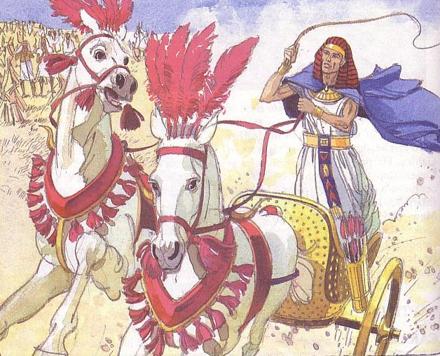
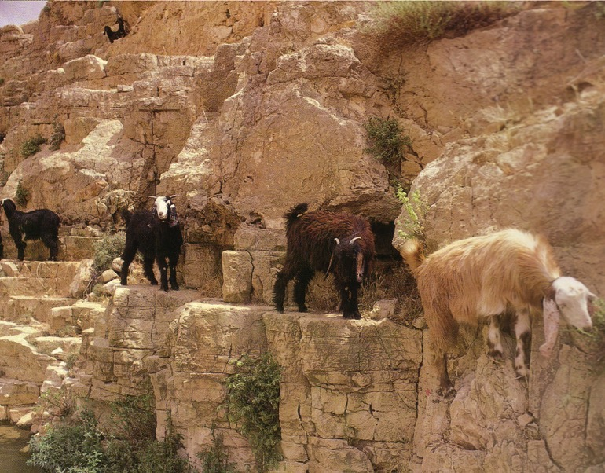
,lJGwk;
12
njhz;ik ,];uNaypd; tho;f;ifKiw
tyJGwk;
,];uNayhy; 150 Mz;Lfs; Ml;rpnra;ag;gl;lJ
,];uNayhy; 1650 Mz;Lfs; Ml;rpnra;ag;gl;lJ

Slide 39
,lJGwk;
ngdpf;Nfah;fs;
rPupaHfs;
12
njhz;ik ,];uNaypd; tho;f;ifKiw
tyJGwk;
NuhkHfs;
flw;fiu
tdhe;juk;
ghgpNyhdpaH
mk;NkhdpaHfs;
mrPupaHfs;
,];uNayH
ngyp];jpaHfs;
NkhthgpaH
vfpg;jpaHfs;
VNjhkpaH

Slide 40
12
,lJGwk;
njhz;ik ,];uNaYf;fhd xU gazk;
tyJGwk;
Nkw;Fk; tlf;Fk;
fpof;Fk; njw;Fk;

Slide 41

vUrNyk;
21
ghjfq;fs;
rhjfq;fs;
fhyq;fs;
Kf;fpaj;Jtk;

Slide 42
vUrNyk;
21
ghjfq;fs;

Slide 43
,lJGwk;
njhz;ik ,];uNaypy; xU gazk;
12
tyJGwk;

Slide 44
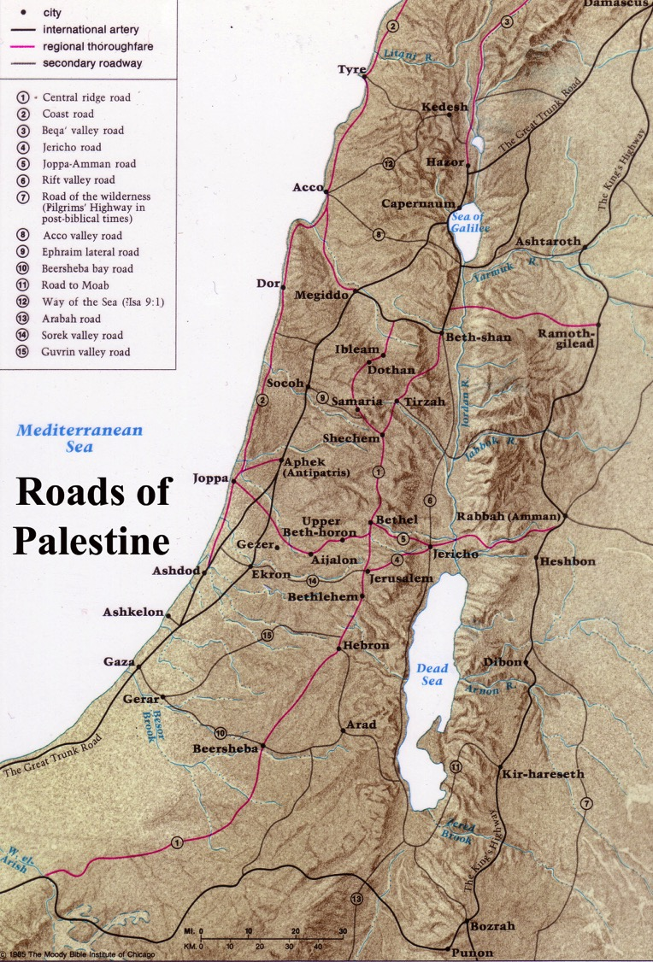
vUrNyk; gpujhd rhiyapy; mike;jpUf;ftpy;iy
12
,];uNaypd; tPjpfs

Slide 45
vUrNyk;
21
ghjfk;
rhjfk;

Slide 46
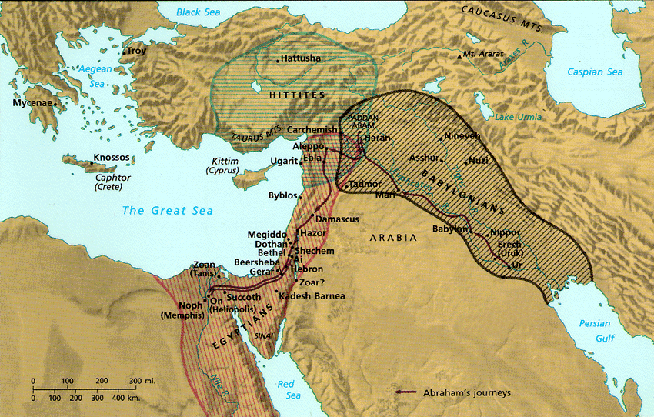
vUrNykpd; %Nyhgha (Strategic) miktplk;
46

Slide 47

vUrNyk; kj;jpa epiyak;
vUrNyk; a+jh> tl Nfhj;jpuj;jpuq;fSf;F mz;ikapYk; ngd;[kPd; Nfhj;jpuj;jpw;F cupajhAk; fhzg;gl;lJ
vUrNyk;

Slide 48
vUrNyk;;
24e
ghjfk;
rhjfk;
ghJfhg;ghd kiyfs;
ePHtsk;

Slide 49
vUrNyk;
23
ghjfq;fs;
rhjfq;fs;
fhyq;fs;
vg+rpaHfs; (1500 fp.K)
rhyNkhd; (971 fp.K)
vNrf;fpah (700 fp.K)
vNrf;fpah (700 fp.K)
586 fp.K
neNfkpah (444 fp.K)
`];NkhdpaHfs; (100fp.K)
kfh VNuhJ (20 fp.K)
etPd kjpy;fs;

Slide 50
Jerusalem
vUrNyk;
22b
ghjfq;fs;
rhjfq;fs;
fhyq;fs;
Kf;fpaj;Jtk;
A+jH
fpwp];jtH
,];yhkpaH
midj;J ,dj;jtH

Slide 51
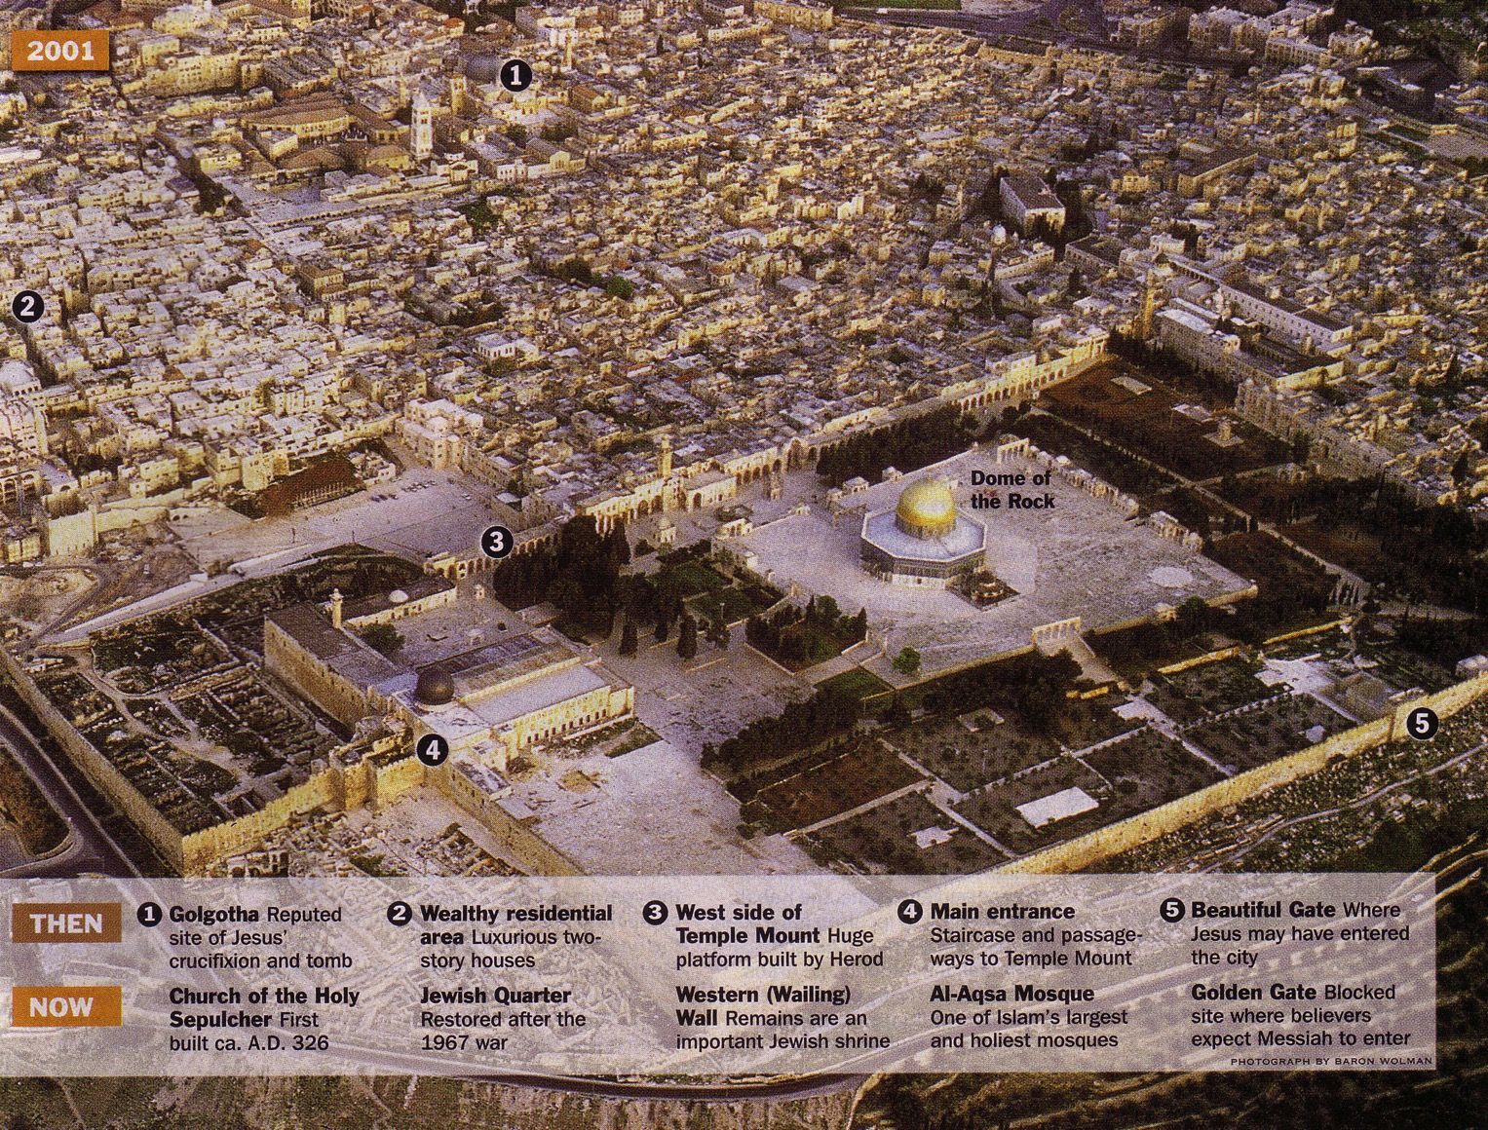

,d;iwa vUrNyk;
22a

Slide 52
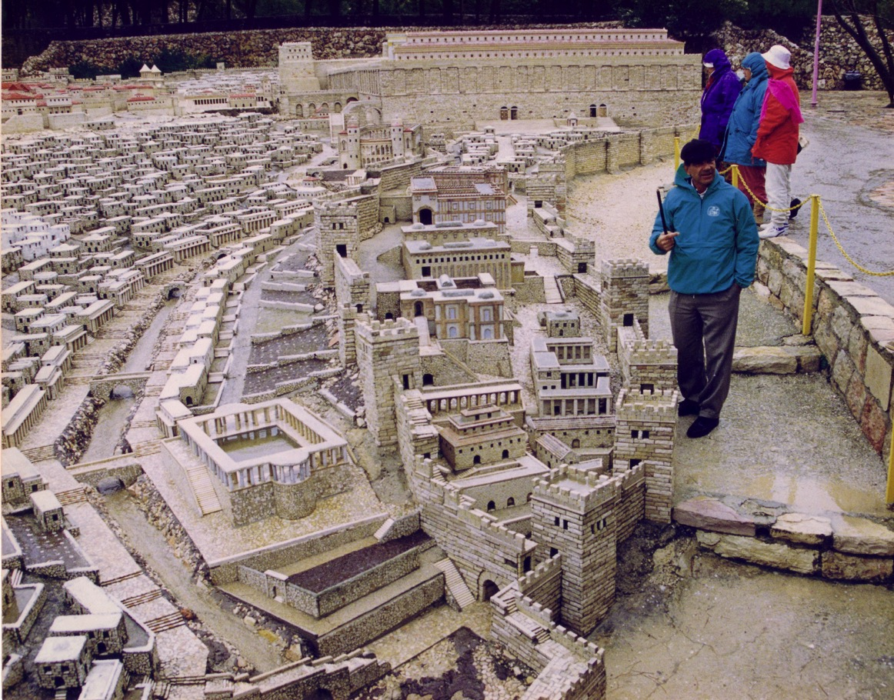
jhtPjpd; efuj;jpd; khjpupaikg;G

Slide 53


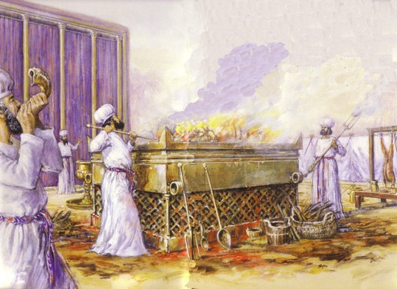
A+Njahtpd; Nkw;F kjpy;

Slide 54

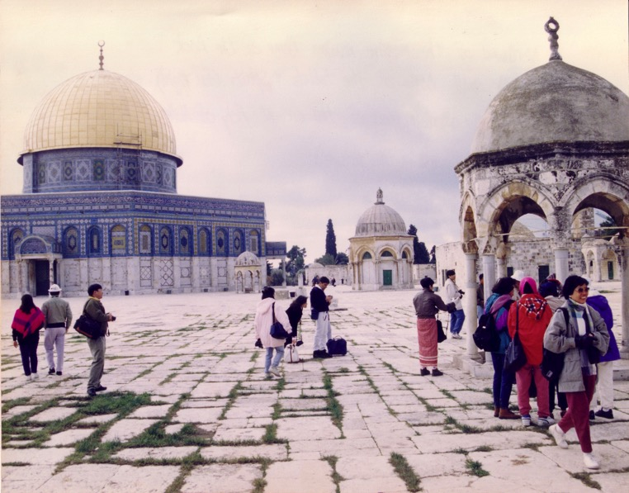

,];yhkpaHfspd; MSif
XkH k#jp
(Dome of the Rock)
my;-mf;]h k#jp

Slide 55

vjpHfhyj;jpy; Ftpkhlj;jpd; (Dome) epiy vd;d?

Slide 56
vUrNykpd; %Nyhgha miktplk;
46
rpe;jidf;F….
flTspd; rpj;jj;ij epiwNtw;Wk;gbahf ve;j %Nyhgha ,lj;jpy; cq;fis epWj;jpAs;shH?
“fHj;juhfpa
Mz;ltH nrhy;YfpwJ vd;dntd;why;>
,JNt vUrNyk;> Gw[hjpfspd; eLtpNy ehd; mij itj;Njd>; mij Rw;wpYk; Njrq;fs; ,Uf;fpwJ.” vNrf;fpNay; 5:5

Slide 57
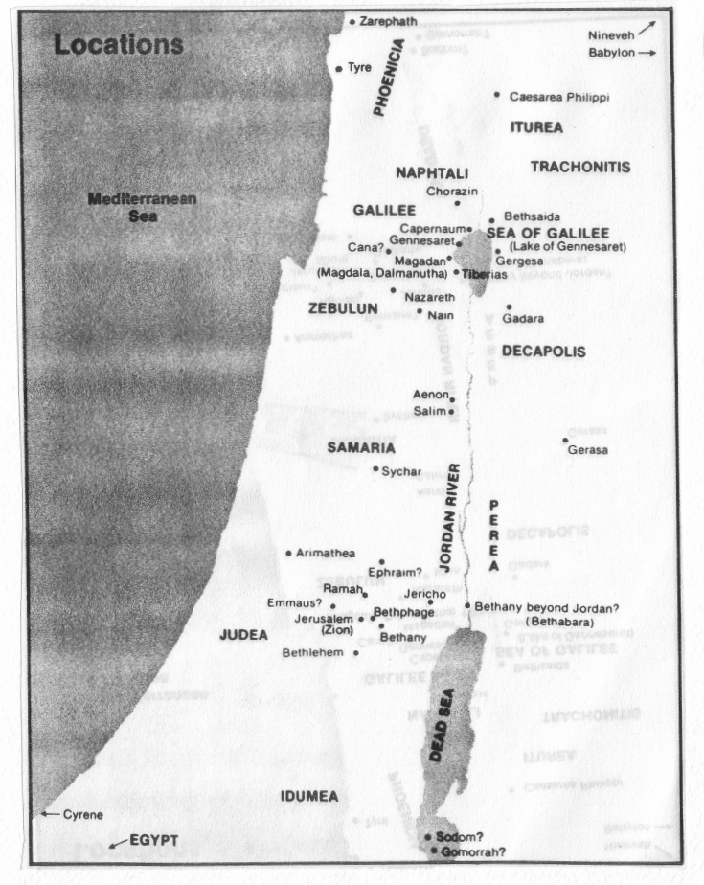
2
FWtpdhtpil #1: ew;nra;jp E}y;fspy; cs;s midj;J Gtpapay; jiuNjhw;w mk;rq;fs;
J}uk; iky;
vUrNykpypUe;J :
ngj;jhdpah 2
ngj;yNfk; 6
nrrupah gpypg;G 105
fhdh 69
fg;gHe$k; 85
vk;kht+H 7
vupNfh 15
NahHjhd; 21
kj;jpaj;jiufly; 40
rPNjhd; 130
rPfhH 31
jPU 106
rhupghj; 118
fg;gHe$kpypUe;J :
ngj;rhapjh 6
nrrupah gpypg;G 27
fhdh 16
ehaPd; 22
kj;jpaj;jiufly; 32
ehrNuj;J 23
rhupghj; 45
jPU 37
Quiz #1

Slide 58


jpUkiwapd;…mbg;gil • BibleStudyDownloads.org
,g;ghlf;Fwpg;Gfis ,ytrkhf ngw;Wf;nfhs;s
Notes:
The Bible…Basically (bb)

